Slide 1
Human Automation Interaction
EIN 4245/6905 – Spring 2024
Dr. Wayne Giang
Lecture 34-36
April 3, 5, 8, 2024

Slide 2
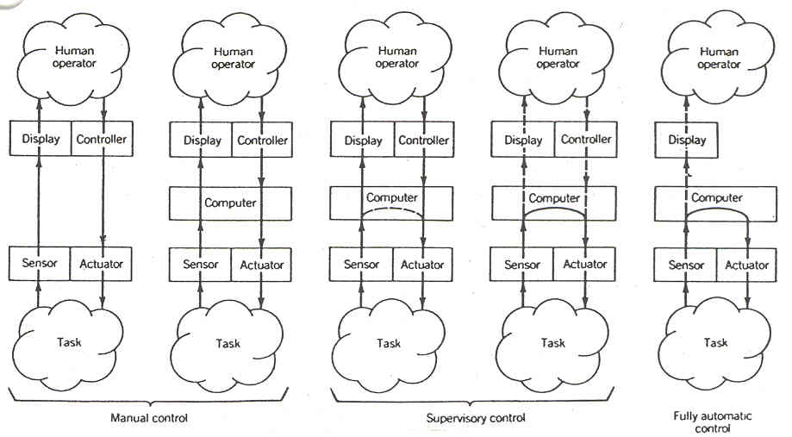
Human-Machine Interaction
Characterizing systems and system types: (What is the degree of manual versus automated control?)
Manual - Complete human control.
Mechanical / electromechano- Humans act as controllers but computers filter information between human and system.
Automated - Supervisory control of fully autonomous systems.
Sheridan, T. B. (1992). Telerobotics, automation, and human supervisory control. MIT press.

Slide 3
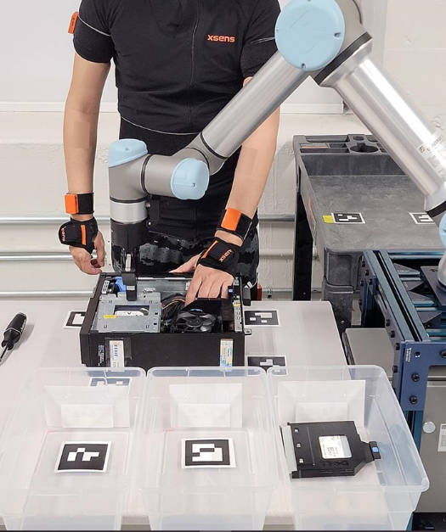
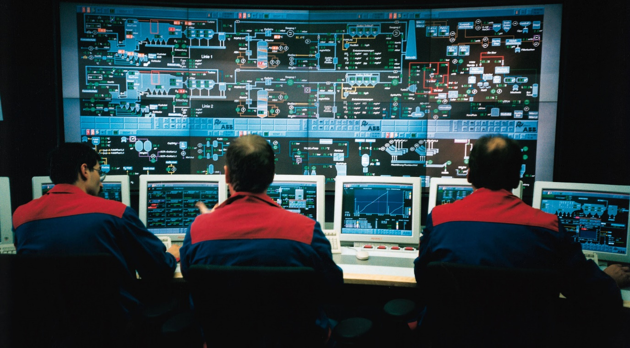

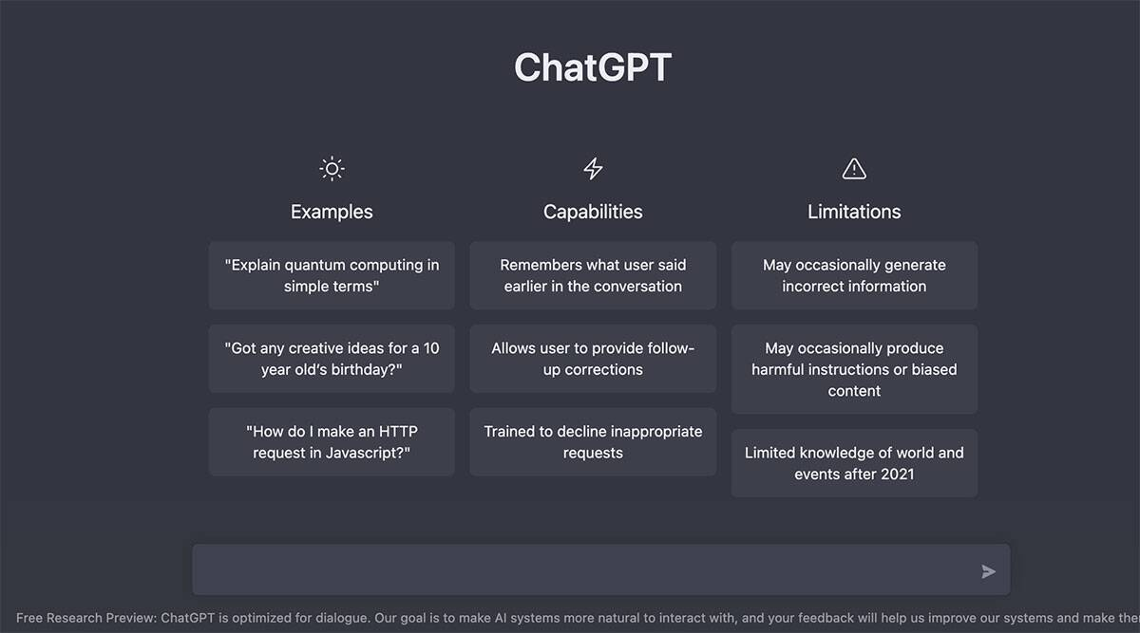
https://en.m.wikipedia.org/wiki/File:Leitstand_2.jpg
https://www.teslasy.com/products/tesla-model-3-y-steering-wheel-fsd-autopilot-assist-ap-chip

Slide 4
Automation Pitfalls
Out-of-the-loop unfamiliarity
Clumsy automation
Automation-induced errors
Behavioral adaptation
Eutectic behavior
Inappropriate trust (misuse, disuse, and complacency)
Inadequate training and skill loss
Job satisfaction and health

Slide 5
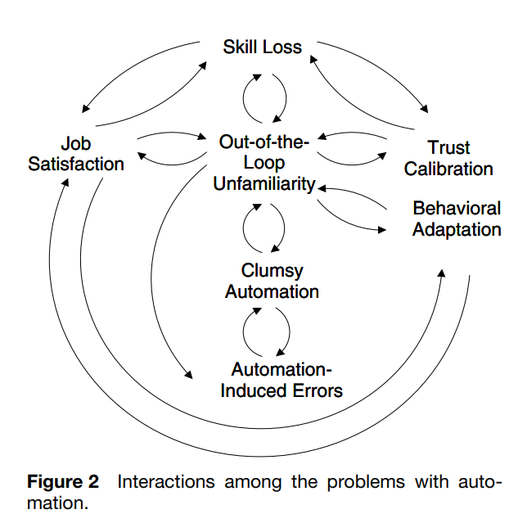
Lee and Seppelt (2012) Human Factors and Ergonomics in Automation Design. In Handbook of Human Factors and Ergonomics. 10.1002/9781118131350.ch59

Slide 6
Human Out-of-the-loop Behavior
In-the-loop behavior: user actively attending and controlling the process
On-the-loop behavior: user monitors the process (i.e., supervisory control)
Out-of-the-loop behavior: all responsibility is left to the automation, can be a consequence of overtrust
Lower Situation Awareness
Slower to detect failures
Loss of skill

Slide 7
Lee and Seppelt (2012) Human Factors and Ergonomics in Automation Design. In Handbook of Human Factors and Ergonomics. 10.1002/9781118131350.ch59

Slide 8
Ironies of Automation (Bainbridge, 1983)
‘Bibby and colleagues (1975) point out: "even highly automated systems, such as electric power networks, need human beings for supervision, adjustment, maintenance, expansion and improvement. Therefore one can draw the paradoxical conclusion that automated systems still are man-machine systems, for which both technical and human factors are important.“’ (pg. 775)
Clumsy automation: Automation that makes easy tasks easier and harder tasks harder (Wiener, 1989)
Lumberjack effect: “In routine operations, an increased degree of automation supports performance, but in failure conditions, increased automation results in more significant impaired performance” (Sebok & Wickens, 2016)

Slide 9
Automation-induced Errors
Brittle failures: Sudden catastrophic breakdowns in the system with little or no warning or indication of malfunction
Example: lane keeping system shuts off in a curve and leaves the lane
Graceful Degradation: gradual predictable decline
Mode errors: Failure to detect the mode and using incorrect inputs for the given mode.
Complex automation can switch modes leading to mode errors.
Configuration errors: Incorrect configuration of automation leading to errors.
Example: Choosing the wrong medical dosage mode in the EHR.

Slide 10
Lee and Seppelt (2012) Human Factors and Ergonomics in Automation Design. In Handbook of Human Factors and Ergonomics. 10.1002/9781118131350.ch59

Slide 11
Behavioral adaptation
Tendency of operators to adapt to the new capabilities of the automation.
i.e., people push the limits of the system
Unexpected effects for the introduction of new automation, especially safety-oriented automation
Examples:
Antilock brake systems (ABS)
Vision enhancement systems

Slide 12
Behavioral adaption
Consequences of pitfall:
Automation intended by designers to enhance safety may instead lead operators to reduce effort and leave safety unaffected or even diminished.
What are the theories, frameworks, or concepts that are relevant to understanding the pitfall?
Diffusion of responsibility -> reduced motivation -> reduced effort
Error frameworks (more errors of omission and commission when working with automation)
Conserve cognitive effort -> humans are effort conserving (heuristics, satisficing)

Slide 13
Behavioral adaption
What are ways we can mitigate or reduce the effects of the pitfall?
As a system designer?
As a user?

Slide 14
Eutectic Behavior
Behavior that approximates an optimal or satisficing response to automation
Goals of system designer may not be the same as the goals of the user
Safety vs Effort
Issues with defining what is “correct reliance behavior” or “appropriate or inappropriate use”
Examples:
Automation that introduces a lot more workload may not be used
Very reliable system may result in high trust

Slide 15
Eutectic Behavior
Consequences of pitfall:
Similar to behavior adaptation, system designers need to understand what the goals of the users will be, make sure there is alignment
What are the theories, frameworks, or concepts that are relevant to understanding the pitfall?
Diffusion of responsibility -> reduced motivation -> reduced effort
Error frameworks (more errors of omission and commission when working with automation)
Conserve cognitive effort -> humans are effort conserving (heuristics, satisficing)

Slide 16
Lee and Seppelt (2012) Human Factors and Ergonomics in Automation Design. In Handbook of Human Factors and Ergonomics. 10.1002/9781118131350.ch59

Slide 17
Automation Reliability
Does the automation do what the operator expects it to do.
User’s perceived reliability of the automated system impacts how they use it:
Automation may be unreliable
The automation does not operate or perform well in certain situations
The human operator may incorrectly “set up” the automation
It appears to be acting erroneously to the operator
Imperfect vs Unreliable
Notes:
If people understand the situations that automation works, then they can even trust “unreliable” systems because they understand the limtiations.
Unreliable has negative connotation.

Slide 18
Trust in Automation (Lee and See, 2004)
Trust: “the attitude that an agent will help achieve an individual’s goals in a satiation characterized by uncertainty and vulnerability” (Lee and See, 2004, pg. 54)
Well-calibrated: Trust in a system should be in direct proportion to its reliability
Distrust: User fails to trust automation leading to underuse
Overtrust / Complacency / Automation Bias: User trusts the automation more than is warranted for its level of reliability
Resolution: Refers to an operator’s ability to identify changes to conditions or goals that can have an impact on the automation’s performance, and to change his or her level of trust accordingly.
Specificity: The degree to which trust is associated with a particular component or aspect of the automation

Slide 19
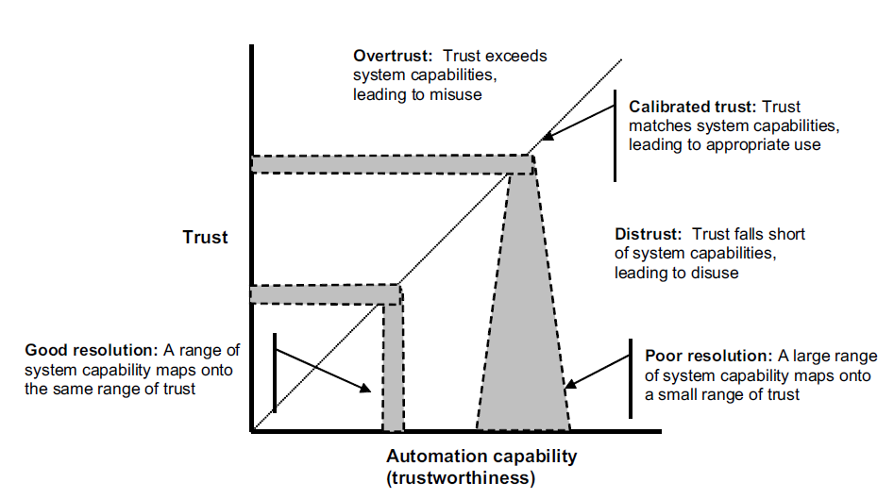
(Lee and See, 2004, pg. 55)
Notes:
Calibration: how closely an operator’s trust in automation matches the capability of the automation.
The diagonal line represents good calibration. Areas above this line correspond to overtrust and below correspond to distrust.
Resolution: Refers to an operator’s ability to identify changes to conditions or goals that can have an impact on the automation’s performance, and to change his or her level of trust accordingly.
This is indicated by the mapping between the blue areas along the trust axis and the automation capacity axis

Slide 20
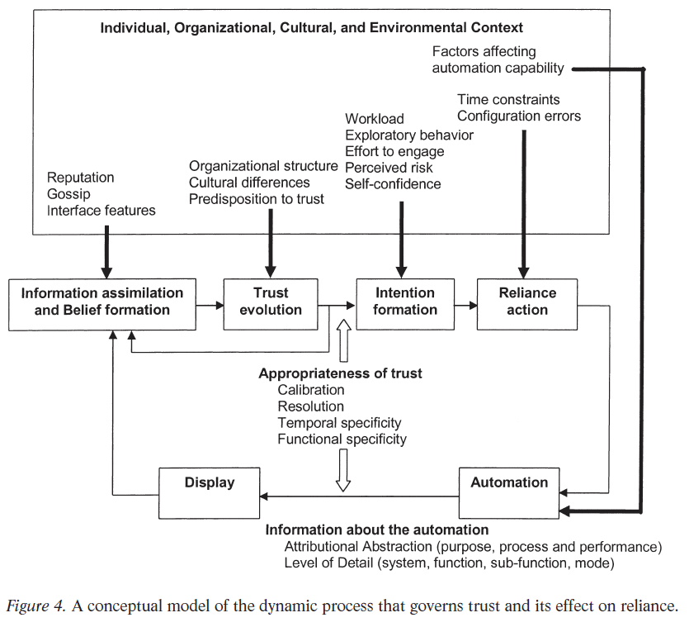
Individual Differences:
Inclination/propensity to trust (Gaines et al., 1997; Stack, 1978)
Trust as an enduring personality trait (Rotter, 1967)
Can be reliability measured: Interpersonal Trust Scale (Rotter, 1980)
High-trusting individuals may actually be better calibrated than low-trusting individuals
(Lee and See, 2004, pg. 68)
Notes:
Trust formation/development -> Performance, Process, and Purpose
Automation Transparency

Slide 21
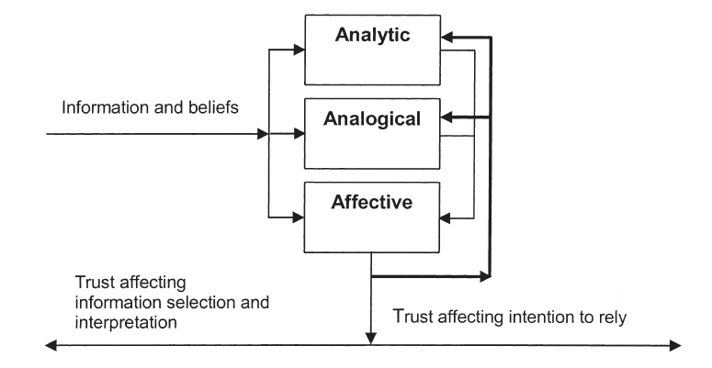
Analytic, Analogical, and Affective Processes Governing Trust
Analytic: evaluation and analysis of information (e.g., knowledge-based)
Analogical: rule-based categorization
Affective: emotional response (automatic processing)
(Lee and See, 2004, pg. 62)
Notes:
Computer ettituqette as an analogical/rule-based way of building trust.

Slide 22
Making Automation Trustable
Design for appropriate trust, not greater trust
Show the past performance of the automation
Show the process and algorithms of the automation by revealing intermediate results in a way that is comprehensible to the operators
Simplify the algorithms and operation of the automation to make it more understandable

Slide 23
Making Automation Trustable - 2
Show the purpose of the automation, design basis, and range of applications in a way that relates to the users’ goals
Train operators regarding its expected reliability, the mechanisms governing its behavior, and its intended use
Carefully evaluate any anthropomorphizing of the automation, such as using speech to create a synthetic conversational partner, to ensure appropriate trust

Slide 24
https://en.m.wikipedia.org/wiki/File:Leitstand_2.jpg
https://www.teslasy.com/products/tesla-model-3-y-steering-wheel-fsd-autopilot-assist-ap-chip

Slide 26
Skill Loss and Job Satisfaction
Dependence on an automated system can leave you with degraded skills for tasks that were previously assigned to the operator
New skills may also be needed for use of automation
Monitoring of automation
Error checking
Problem solving and troubleshooting
Training may be lacking for these skills
Automation in workplaces can lead to decreased job satisfaction:
Less “skill” needed
Higher demands and lower decision latitude

Slide 28
What other factors impact HAI?
Workload and Situation Awareness
Loss of Human Cooperation
Training and Certification
Loss of human cooperation: automation can take away cues that existed in human-to-human interactions
Sound and tone of voice between pilots and air traffic controllers
Automated phone menus / online digital chatbots

Slide 29
Types of Automation

Slide 30
Types of Automation (Parasuraman, Sheridan, Wickens, 2000)
Four-stage Model of Human Information Processing
Sensory Processing
Perception / Working Memory
Decision Making
Response Selection
System functions that can be automated
Information Acquisition
Information Analysis
Decision and Action Selection
Action Implementation
Notes:
Information attention: replaces elective attention (Information acquisition, selection, and filtering)
Analysis: cognitive process of perception and working memory. Situation assessment, inference, diagnosis, picture of the task-relevant information (SA) (Information integration)
Decision: Diangosis is distinct from choice. Sensitvitiy is different from response criterion. “Value of outcomes” is considered. Replaces the decision and action selection part of HIP. TCAS recommendations. Explicitly consider value. (Action selection and choice)
Action implementation: actually executing the task (action sequence, carry out action, gulfs of execution etc). Automatic stock tradigin. Autopilots.

Slide 31
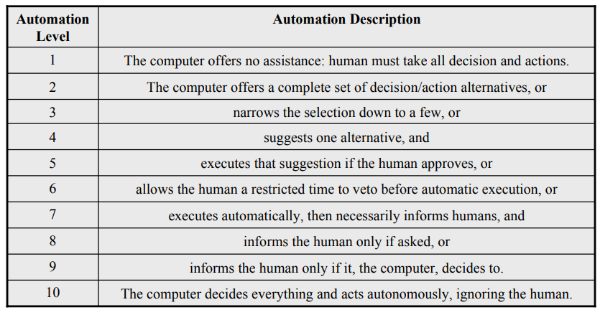
Sheridan and Verplank’s 10 Levels of Automation of Decision and Action Selection (1978)
Notes:
Text book has similar set of 8 levels of automation, Levels 2+3 map onto 2 in the reduced set. And it removes level 9 to get down to 8 total.

Slide 32
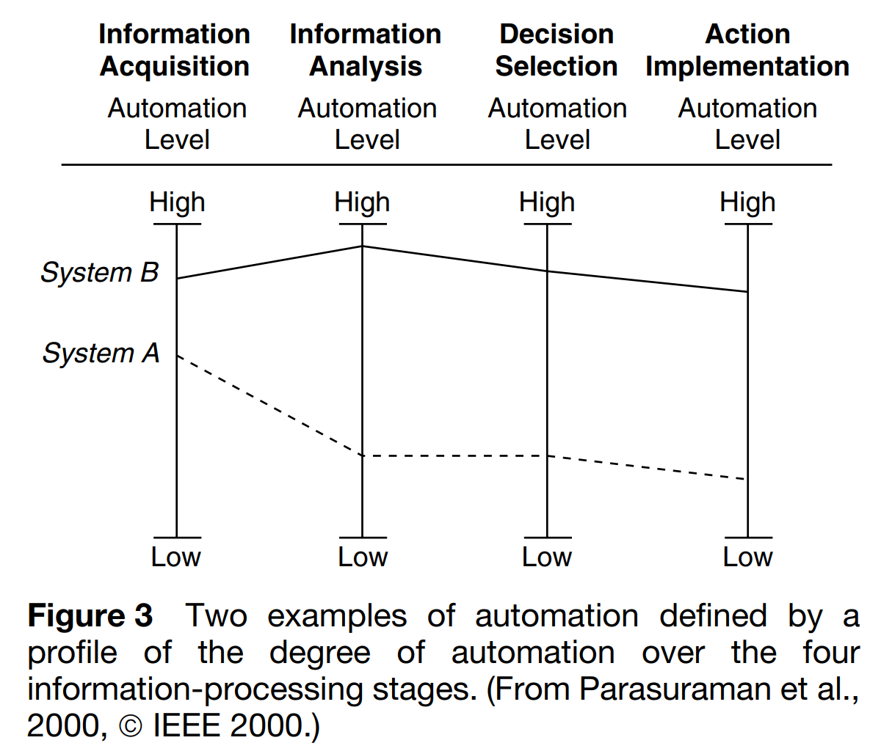

Slide 33
Levels of Automation
Endsley & Kaber (1999)’s Discrete Levels of Automation

Slide 34



Tools, Prostheses, and Agents
Metaphors for how humans can work with automation
Describes changes in the “locus of control”
Tools: “something (such as an instrument or apparatus) used in performing an operation”
Prostheses: “an artificial device to replace or augment a missing or impaired part of the body”
Agents: “one that acts or exerts power”, “one who is authorized to act for or in the place of another”

Slide 35
Tools, Prostheses, and Agents
Cognitive Tools:
“extends and complements human capabilities”
Operators work directly with the environment, automation augments those interactions
Clear influences and failures
Cognitive Prostheses:
“replaces a human function with a more capable version”
Eliminates variable or error-prone aspects of human behavior
Good for routine, low-risk situations
Lower flexibility

Slide 36
Tools, Prostheses, and Agents
Cognitive Agents:
“acts as a semi-autonomous partner” to the user
Responsibility in the agent to act on behalf of the user in the environment
Not directly controlled by the user
Autonomy and authority are important
Coordination and teamwork are key when dealing with agents
How does the user and the agent infer each others intent?
How does the user know what the agent is doing?
Automation transparency
Explainable AI
How does the agent understand the status of the user?
User modelling
Design of controls

Slide 37
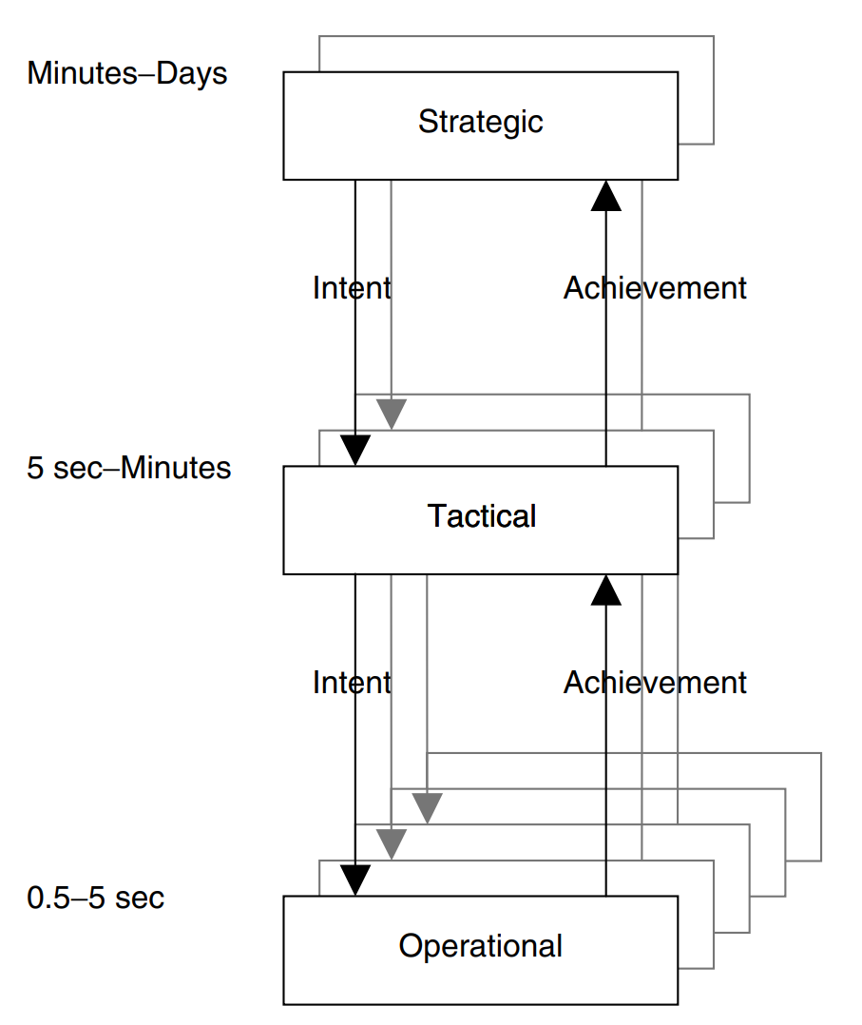
Multi-level Control
Time span of a task
Milliseconds, Minutes, Hours, Days, Months, Years
What is the time span of the task that the automation is support?
How well does that match against “human” time spans?
Reveals important coordination and feedback requirements

Slide 38
Multi-level Control
Strategic Automation: balancing values and costs and defining goals
Tactical Automation: priorities and coordination
Operation Automation: perceptual cues and motor response

Slide 39
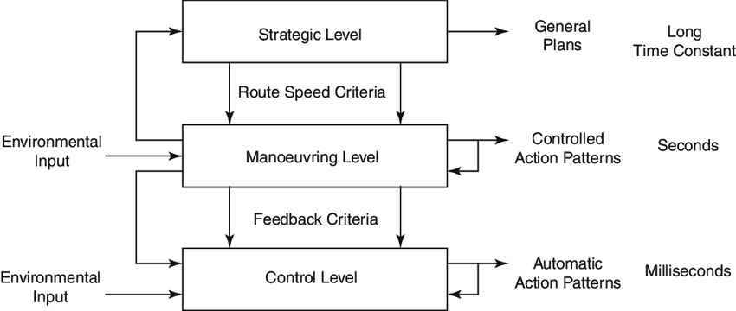
Multi-level Control in Driving
Michon (1985)

Slide 40
How do we enhance human-automation interaction?

Slide 41
Function Allocation
Determining which functions of a system should be carried out by a human and which functions of a system should be carried out by the automation
Static function allocation vs. dynamic function allocation
Important to understand the tasks and functions that are required
Example:
Group work in school
Flight path management during landing

Slide 42
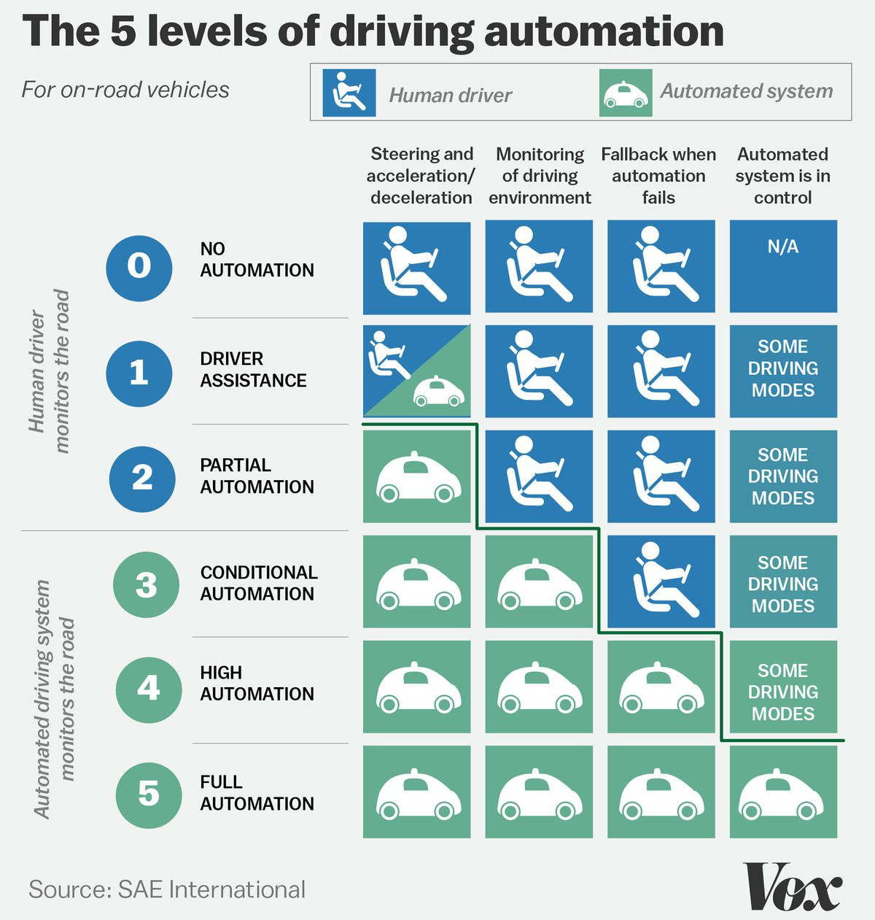

Slide 43
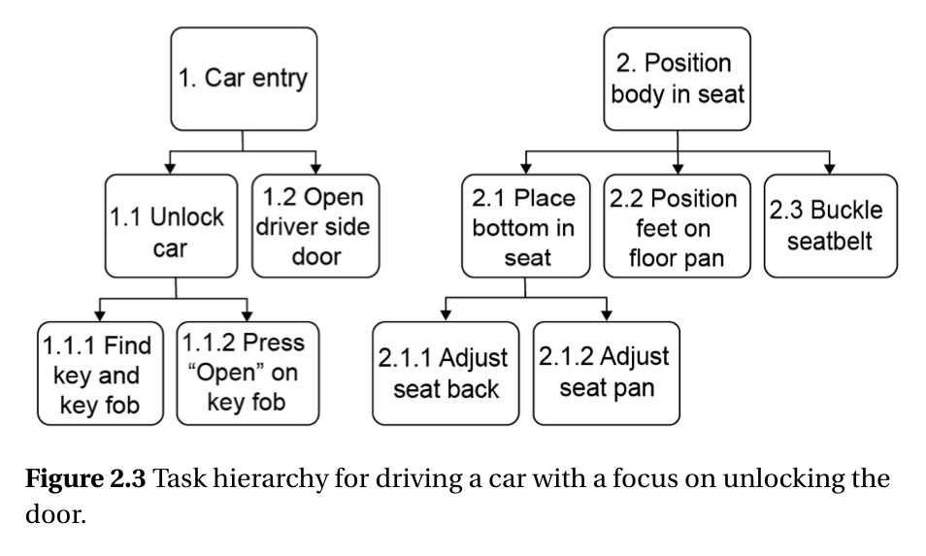
Hierarchical Task Analysis
Break a task down into subtasks
Repeat (until satisfied)
Focus on observable actions
Start with user goal
Break down into main tasks, subtasks, and plans
Notes:
HTA examines tasks by a systematic process of redescription of goals and tasks
A task is redescribed in terms of a set of subordinate subtasks and an organizing component called a “plan”
Plans specify the conditions under which subordinate tasks have to be carried out to meet the system goals
Plans are the key to accounting for complexity in tasks
HTA is a method of representing task information through a hierarchy of goals, operations, and plans. However, the process by which this is achieved is of greater importance

Slide 44
What is Task Analysis
A way of systematically describing human interaction with a system to understand how to match the demands of the system to human capabilities
Study of the cognitive or physical activities required of a person or team to achieve a goal
Results can differ based on which users are studied even when the technologies are similar

Slide 45
Goals, Functions & Tasks
Goal: end condition or reason for performing the tasks
Functions: the general transformations needed to achieve the goal, a group of tasks that share a collective purpose
Tasks: specific activities needed to carry out a function
Notes:
Goals --> do NOT depend on technology -> want to listen to music
Functions --> do NOT specify particular tasks -> select music to play, start the music
Tasks --> technology can change tasks substantially -> steps we take to do that

Slide 46
How to Perform a Task Analysis
Define the purpose and identify the data required
Collect task data
Interpret task data
Innovate from task data

Slide 47
Define the Purpose of the Task Analysis
Define what design considerations the analysis should address, for example:
defining training requirements
identifying software/hardware design requirements
redesigning processes
assessing system reliability
evaluating staffing requirements
estimating workload
The defined purpose will influence the information that is gathered
Notes:
Focus the T.A. on the end use of the data
Point out Cognitive Task Analysis
Complex decision making, problem solving, diagnosis
Much conceptual knowledge needed
Large and complex rule structures
Performance depends on memory of information that needs to be retained for seconds or minutes
Would have more knowledge elicitation rather than direct observation of just the task motions.

Slide 48
Categories of Required Data
Hierarchical relationships
Information flows
Task sequence
Location and environmental condition
Notes:
- probability of performing task incorrectly
- frequency of occurrence
- importance

Slide 49
Types of Data
Hierarchical relationships describe:
function, task, subtask relationships
how tasks are composed of subtasks
how groups of tasks combine into functions
Function
Task 1
Task 2
Subtask 1
Subtask 2
Subtask 3
Notes:
Cassette player
What, why, and how tasks are performed
Moving up the hierarch describes why a task is performed.
Moving down describes how a task is performed.
Can be used to identify new ways of doing things. (functions can be generalized across different technologies, just by changing the tasks).
Playing music. -> How is it done on our phones? What has changed in the age of spotify and streaming services from before they existed?

Slide 50
Types of Data
Information flow:
Describes the communication between people and the roles that people and automated systems play in the system
Examples:
individuals and their roles and responsibilities
skills and knowledge of the individuals
flow of information
information needed and information generated by each individual
Notes:
Thinking about individuals and their roles can help identify important design considerations regarding the flow of information and resources
Who performs the task, with what indications, and with what feedback?
Music player user -> device (interface, buttons) -> clicks, motors, beeps, music?

Slide 51
Types of Data
Task sequence:
Describes the order of tasks and the relationships between tasks over time
Useful in determining how long a set of tasks will take to complete or in estimating the number of people required to complete them
Specific task sequence information include:
Goal or intent of task
Sequential relationship (what must proceed or follow)
Triggers or event that start a task sequence
Results or outcome of performing the tasks
Duration of task
Number and type of people required
Tasks that will be performed concurrently
Notes:
When, in what order, and how long tasks take to perform.
Specific order (plan) to play music.
PLANS in TA

Slide 52
Types of Data
Location and environmental conditions:
Describes the physical world in which the tasks occur
Examples:
Path of motion
Location where particular tasks should be performed
Physical structures (walls, partitions, desks)
Tools and their location
Conditions under which the tasks are performed
Notes:
Where and under what physical and social conditions tasks are performed.
On the go, exercise, office settings. Lots of places.
Water proof or not?
CD players and motion + bump resistance?

Slide 53
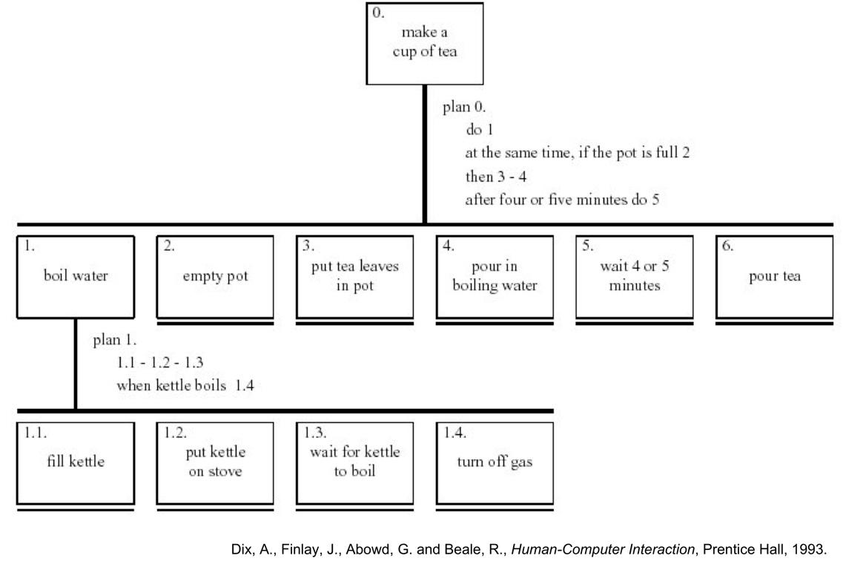
Hierarchical Task Analysis
Goal
Tasks
Subtasks
Tool: Task Architect (www.taskarchitect.com)

Slide 54
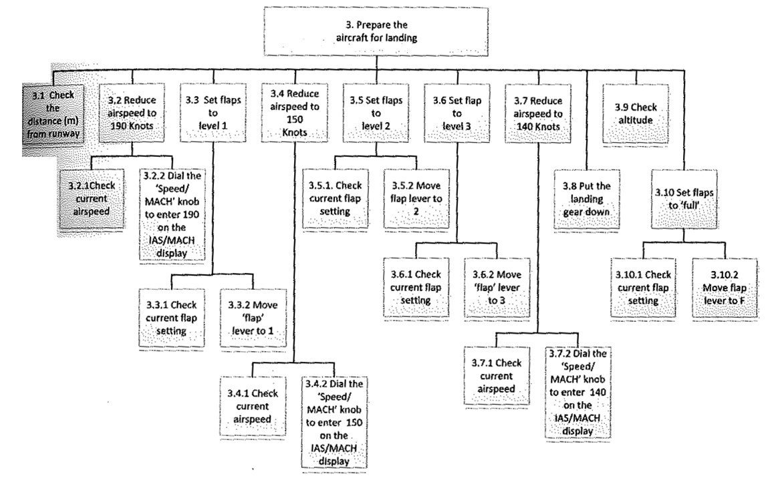
Another Example of HTA: Extract of HTA for the task ‘Land aircraft X at New Orleans Airport using the autoland system’
Source: Marshall et al., 2003

Slide 55
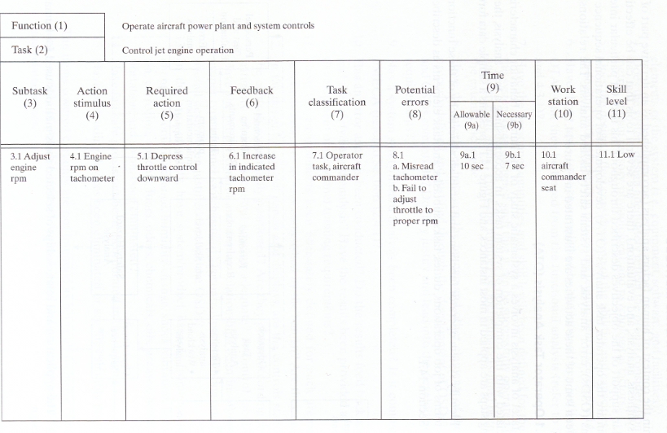
Table representation of HTA
Source: Blanchard & Fabrycky (2006). Systems Engineering and Analysis.
Notes:
- Each row is a subtask
- Columns described the tasks

Slide 56
Task Data Collection Methods
Observe task performance
- Direct observation
- Walk-through
- Think aloud verbal protocols and probe questions
Ask users or experts
- Talk-through
- Interviews
- Surveys and questionnaires
Use existing information
- Documentation
- Training materials
Choose a method that fits

Slide 57
Hierarchical Task Analysis (Example)
In order to enjoy music on Walkman
Insert tape
Open Walkman
Put cassette inside
Close it
Press play
Insert headphones into Walkman
Put on headphones
Notes:
Tie this back to the little girl’s description from the video.

Slide 58
Hierarchical Task Analysis (Example)
0. In order to enjoy music on Walkman
Insert tape
Open Walkman
Find open button
Press open button
Open the cassette tray/wait for tray to open
Put the cassette inside
Find a cassette you want to listen to
Choose a side you want to listen to
Orient the cassette correctly
Insert cassette into tray
Close it
Press play
Insert headphones into Walkman
Put on headphones
Notes:
Talk about stopping criteria.

Slide 59
Stopping Criteria
You need to choose an end point for your analysis:
PxC rule:
If Probability(mistake) x Cost(mistake) > threshold, then decompose
Reduction to motor tasks
Pitfalls:
When you find what you expect to find
When you run out of readily available information
When a design solution is detected

Slide 60
HTA – Graphical Representation
In order to enjoy music on Walkman
Insert tape
Open Walkman
Find open button
Press open button
Open the cassette tray/wait for tray to open
Put the cassette inside
Find a cassette you want to listen to
Choose a side you want to listen to
Orient the cassette correctly
Insert cassette into tray
Close it
Press play
Insert headphones into Walkman
Put on headphones
Plan 0: do 1-2. If headphones aren’t inserted, do 3-4.

Slide 61
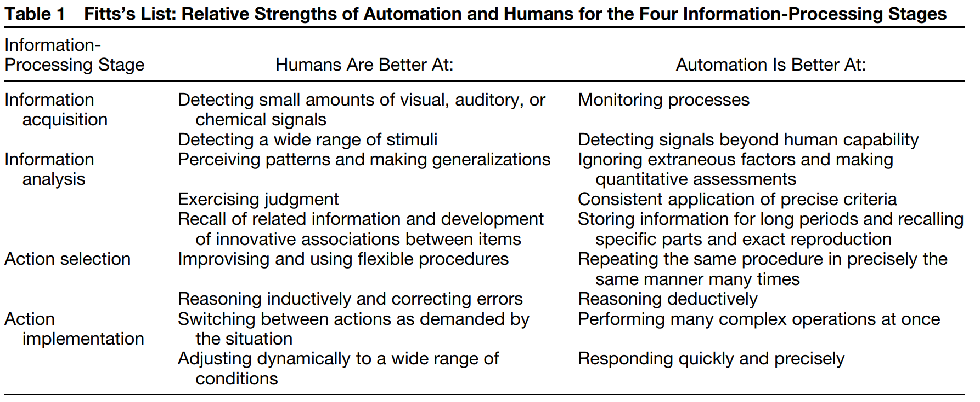
Fitts’s List (Lee, 2006)

Slide 62
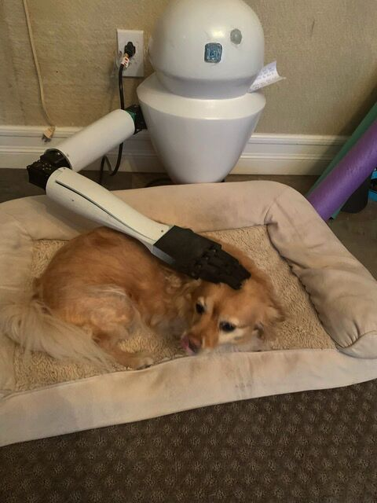
Other Factors to Consider
Technology capability and feasibility
Reliability
Risks to health and safety
Physical/Ergonomic Issues
Cognitive
Stress
Costs
https://www.petguide.com/pets/blog/news/high-school-student-invents-dog-petting-robotic-arm-44470185

Slide 63
Function Allocation (FA) Schemes
Endsley & Kaber (1999)’s Discrete Levels of Automation

Slide 64
Dynamic Function Allocation
Adaptable Automation:
Operator controls when automation is used/engaged
Example: ACC can be turned on or off
Reliance behavior (decision to use the automation) depends on perceived risk, workload, trust, and self-confidence
Additional workload for the user in deciding when to engage/disengage automation

Slide 65
Dynamic Function Allocation
Adaptive Automation:
Automatically adjusts level of automation depending on the user
Performance
Operator state (workload, stress, anxiety, distraction)
Task situation
Typically increases level of automation as user workload increases or capacity decreases

Slide 66
Dynamic Function Allocation
Adaptive Automation:
Challenges in detecting user state:
Physiological sensors (EEG, eye tracking and pupil width)
Task performance
Adaptive automation is a “meta-automation” and can also have its own set of problems if not implemented well
E.g., Mode errors may be more common since automation is changing dynamically

